Slide 1
Advanced Biological Control System

Slide 2

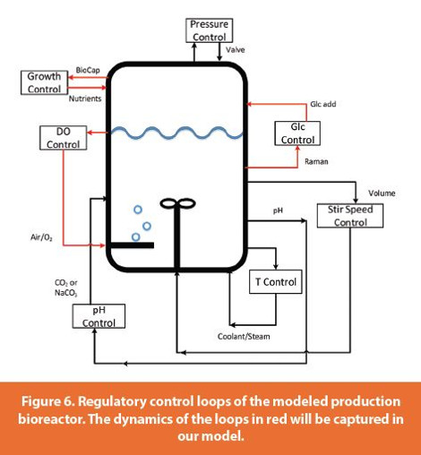
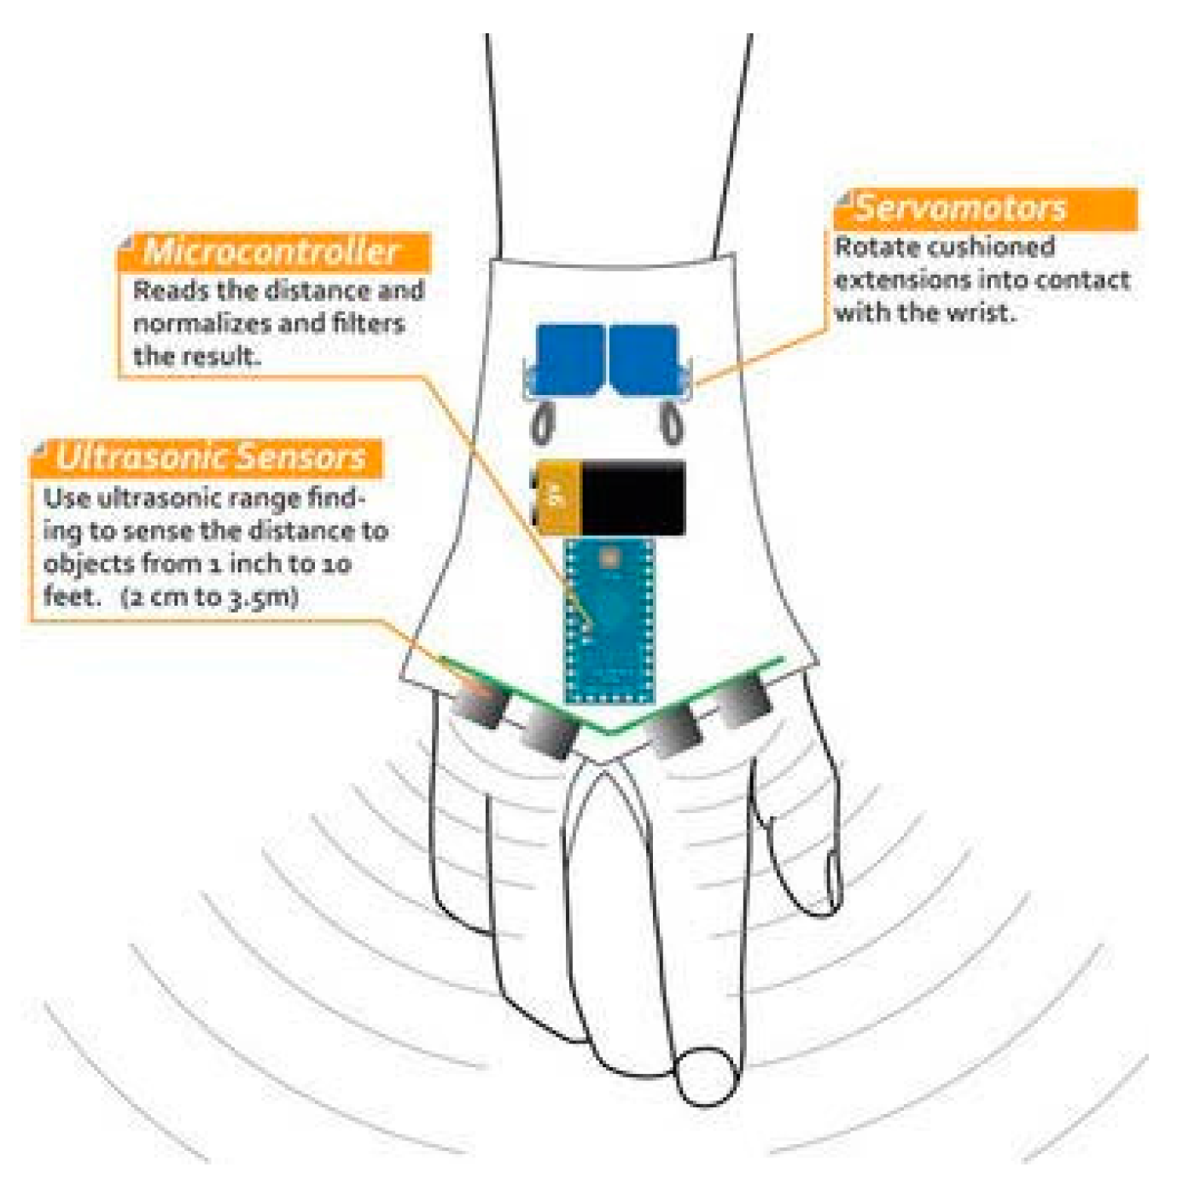
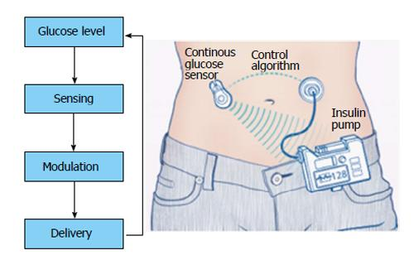
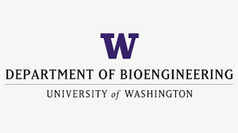


BIOEN 498/599: Advanced Biological Control Systems
Winter, 2024. MW 1:00 – 2:20.
Instructor: Joseph L. Hellerstein, Senior Fellow (eScience Institute), Affiliate Professor (Allen School of Computer Science)
jlheller@uw.edu
Bioreactor Control
Medical Device Control
Insulin Control
Engineers have long used feedback to control unreliable devices and regulate complex processes. Applications in biology include bioreactors, medical devices, and the analysis of biochemical networks This course teaches the basics of control engineering to bioengineers and allied disciplines. Some learning objectives are:
learn common controller and control system designs;
analyze the controllability of biochemical networks, the extent to which there are inputs such as temperature or pH that control outputs such as metabolite concentrations;
apply linear system theory to predict behaviors such as stability, settling times, and overshoot; and
develop skills with control system design.
Ideally students have taken BIOEN 336 (Bioengineering systems & control) or equivalent.

Slide 3
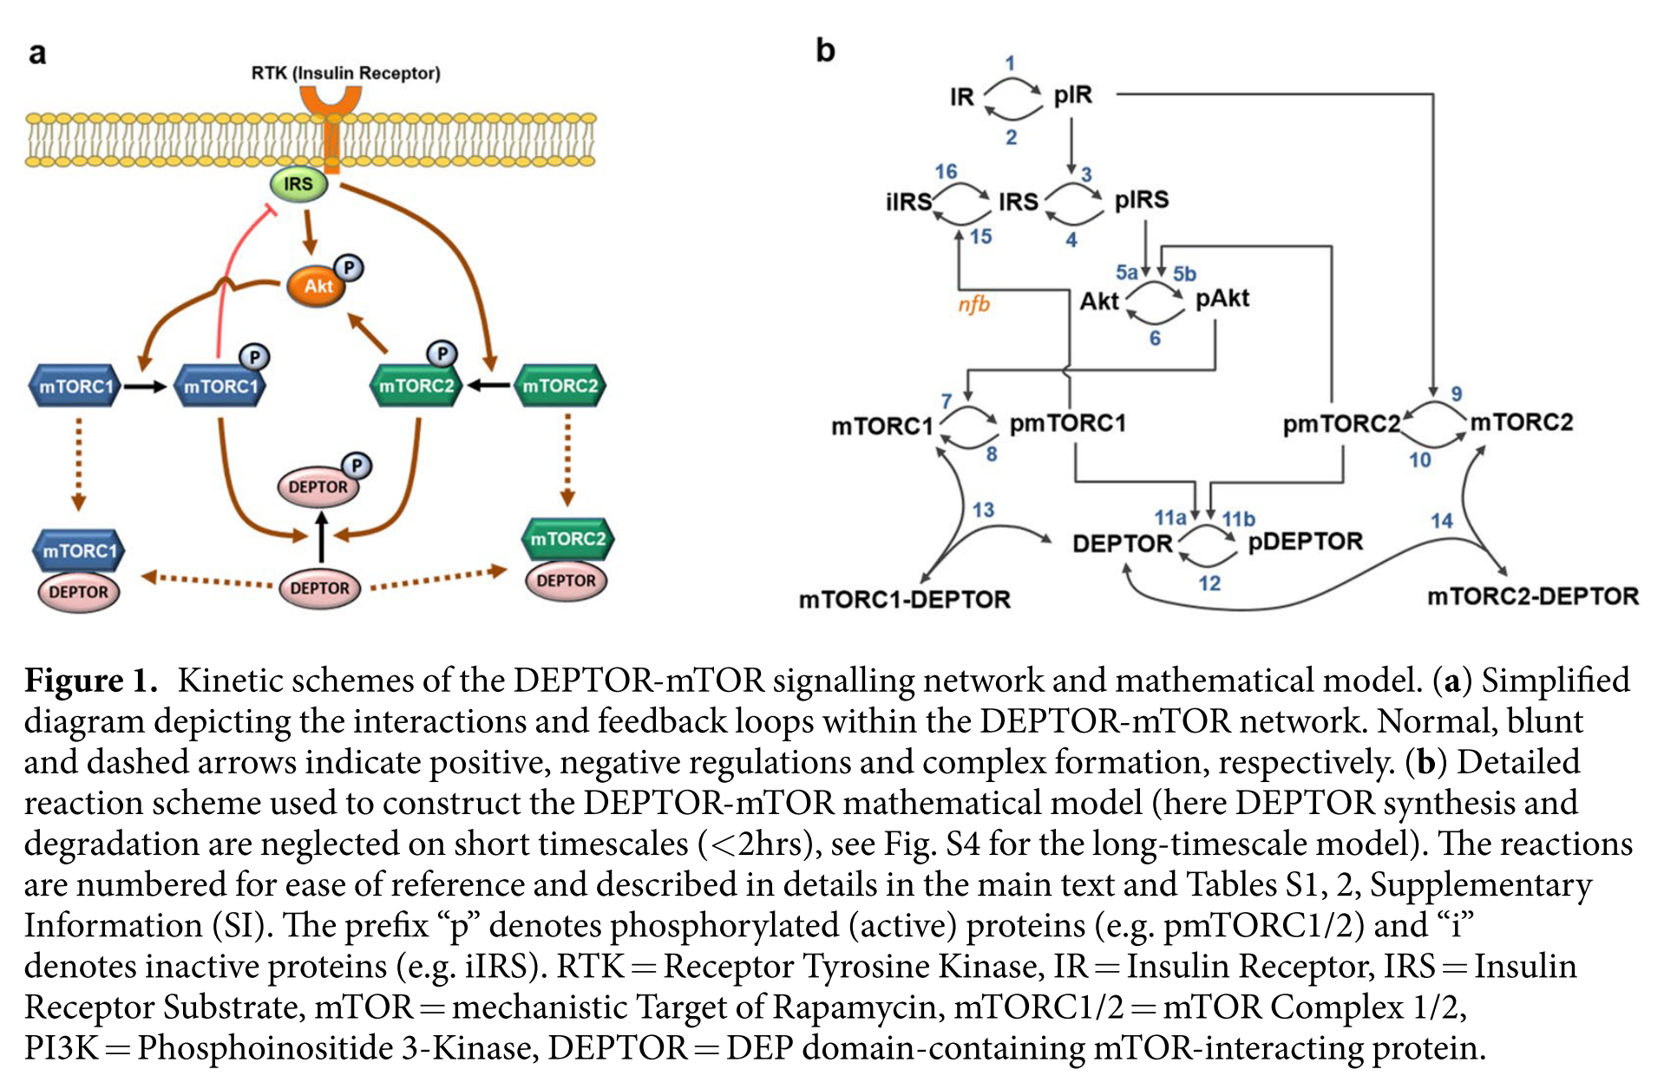
Insulin Receptor
Insulin Receptor
Substrate
or

